Slide 1




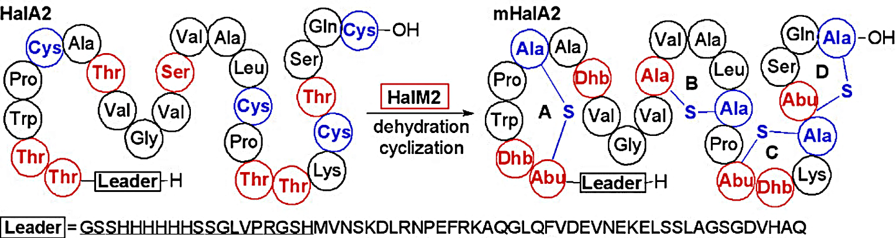
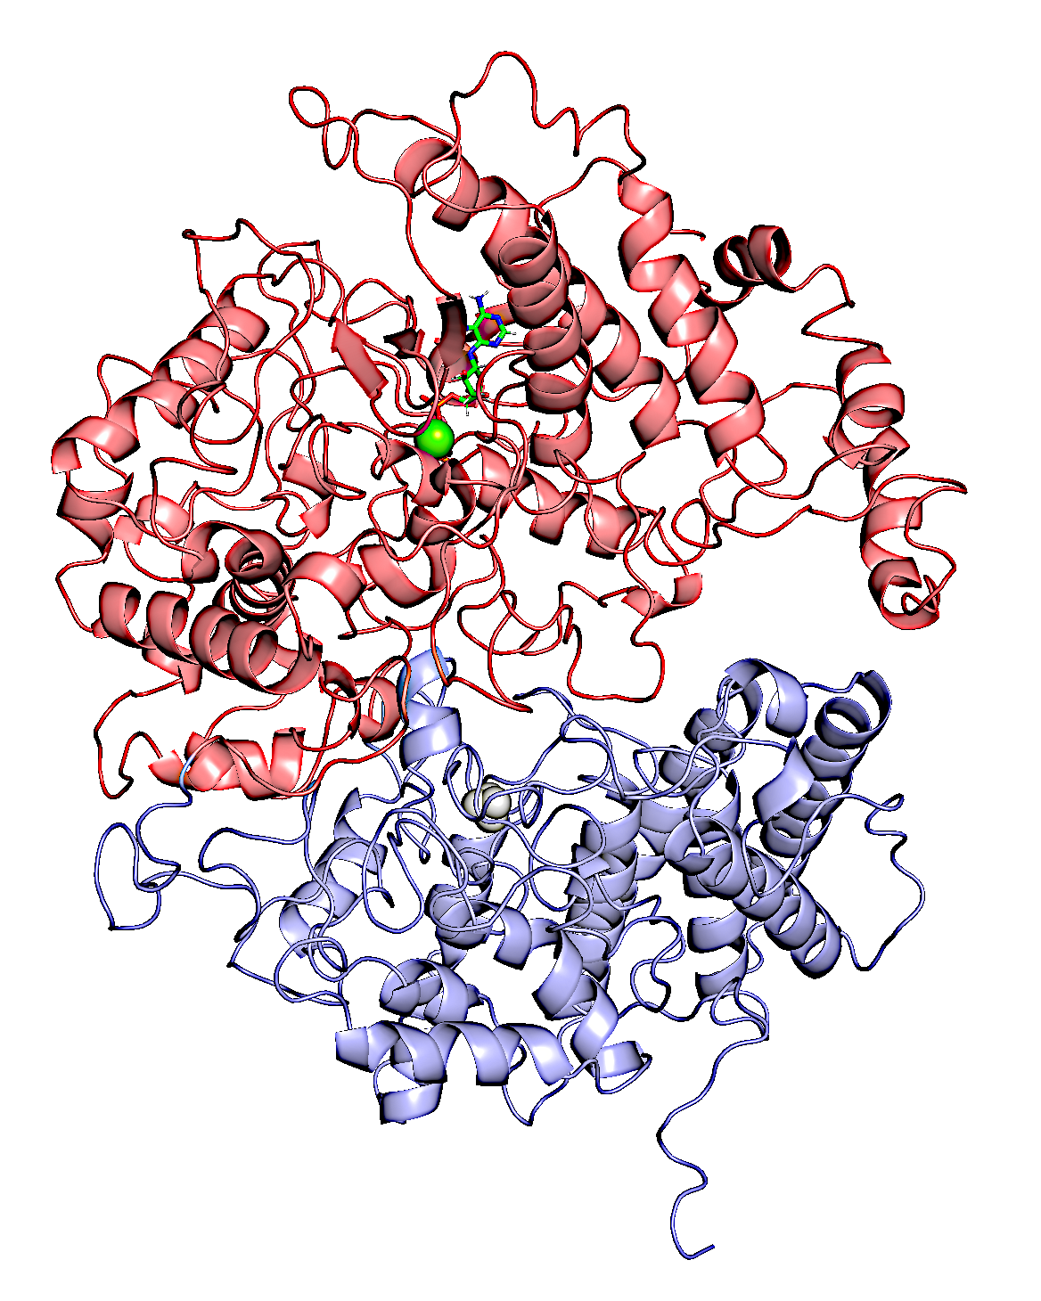
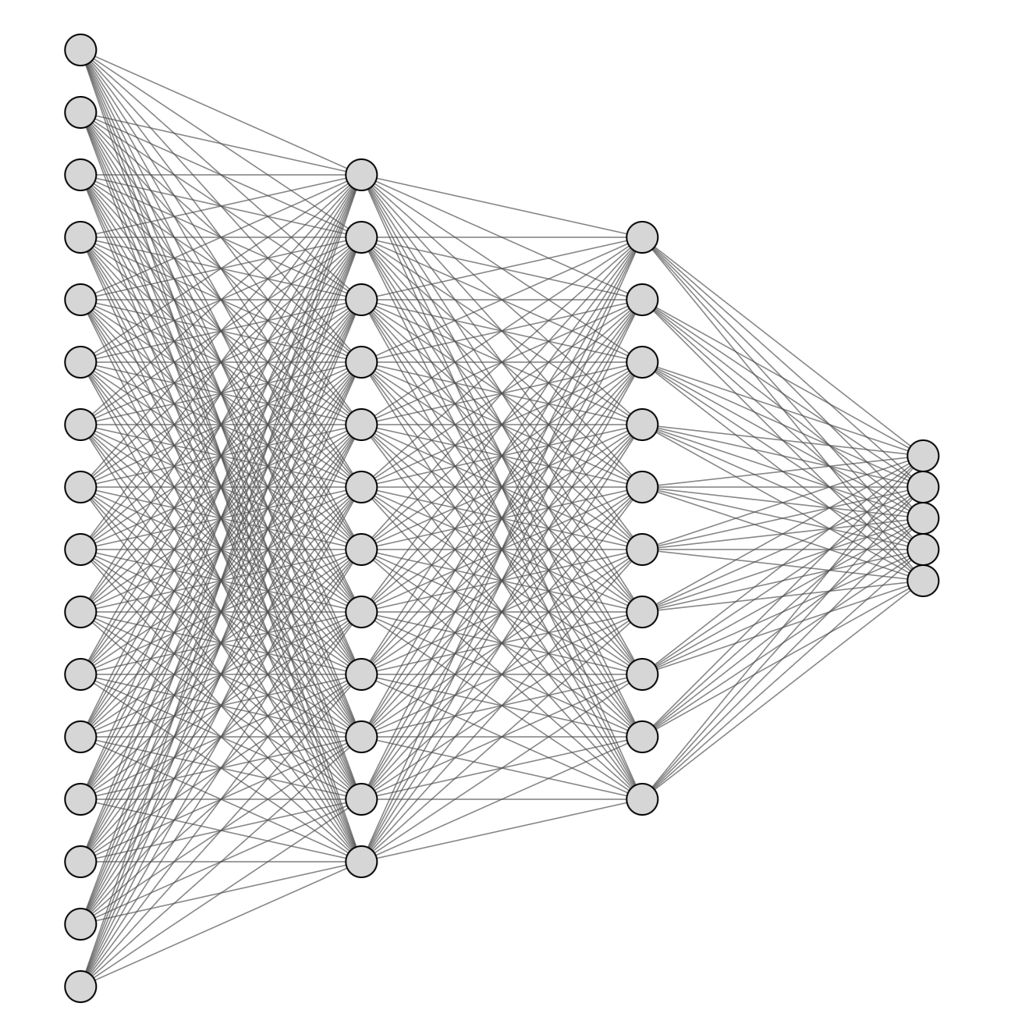
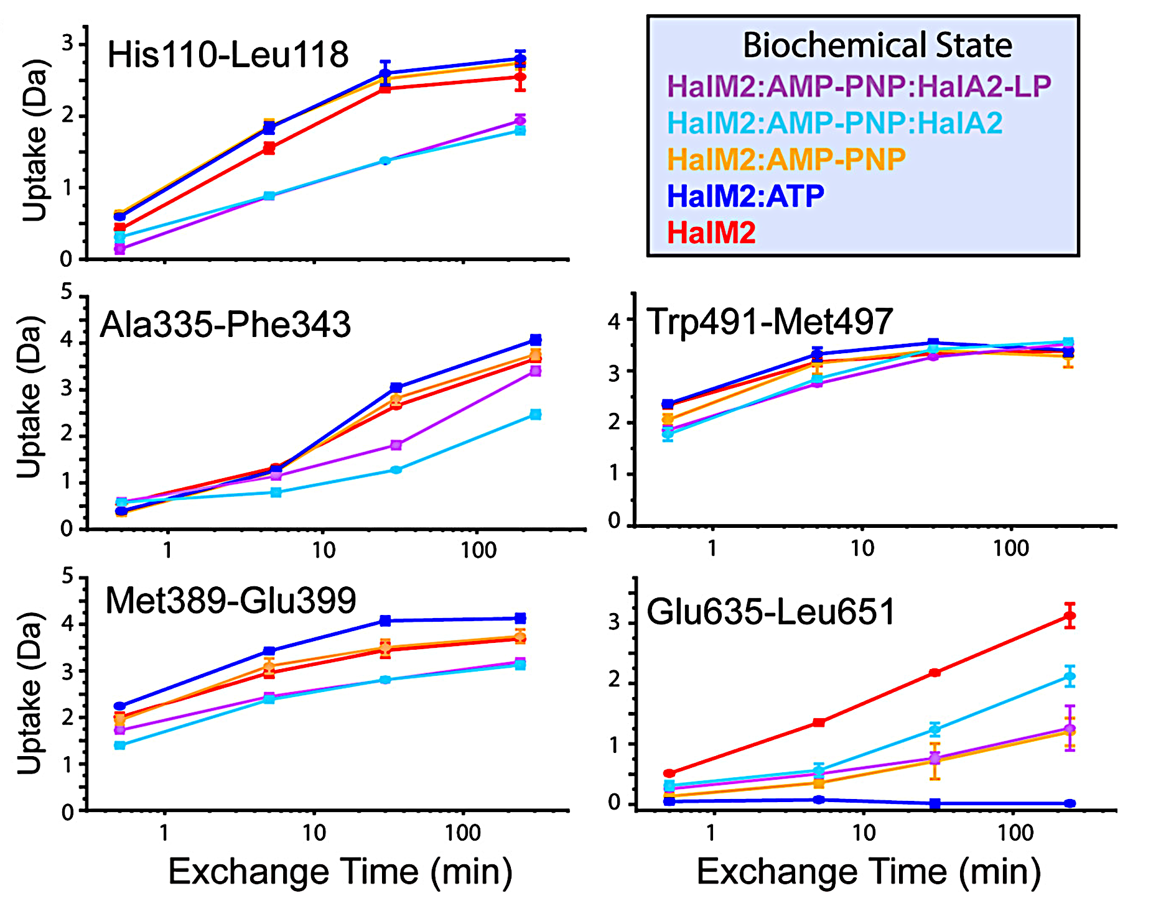
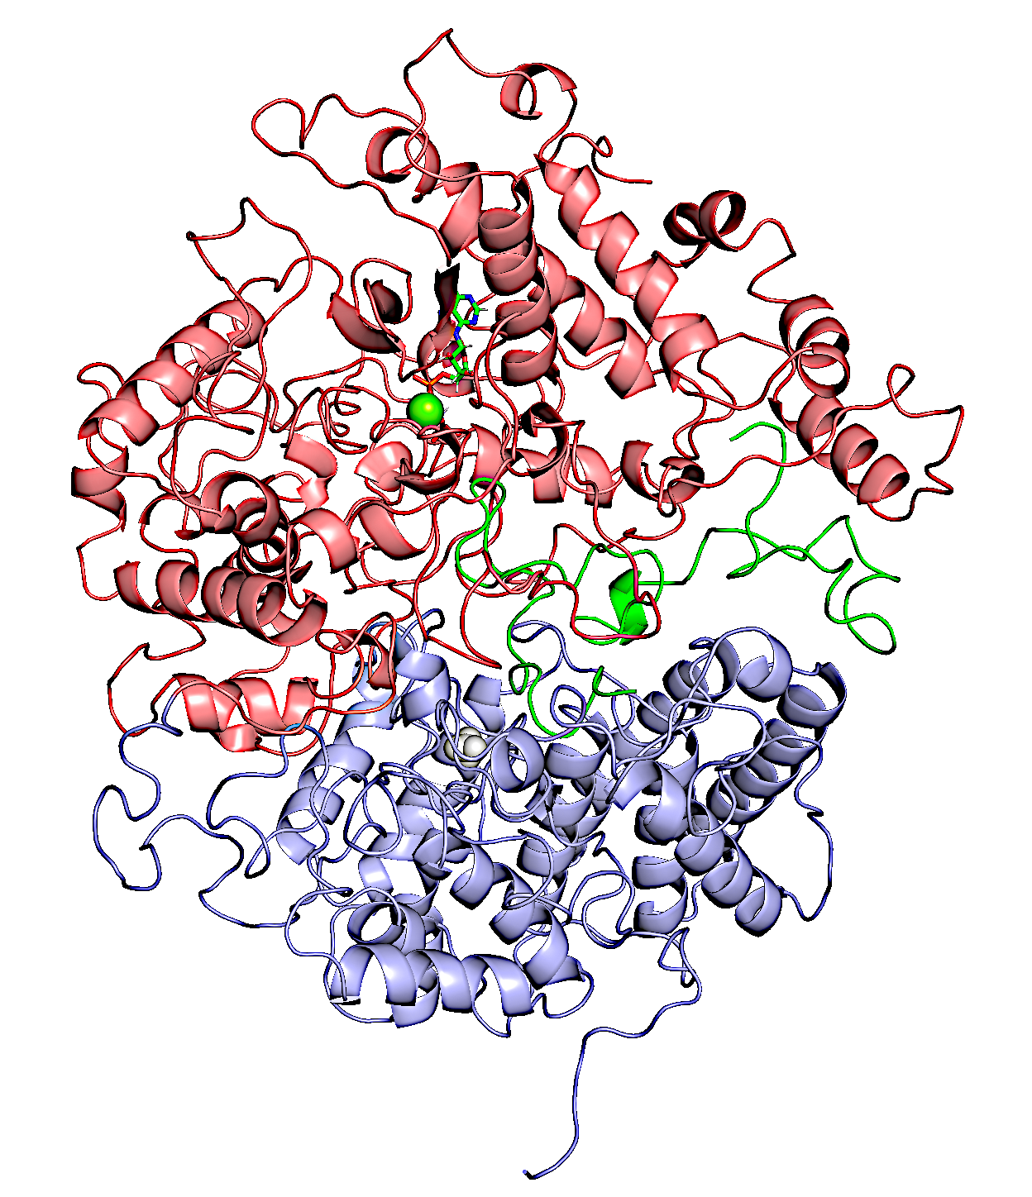
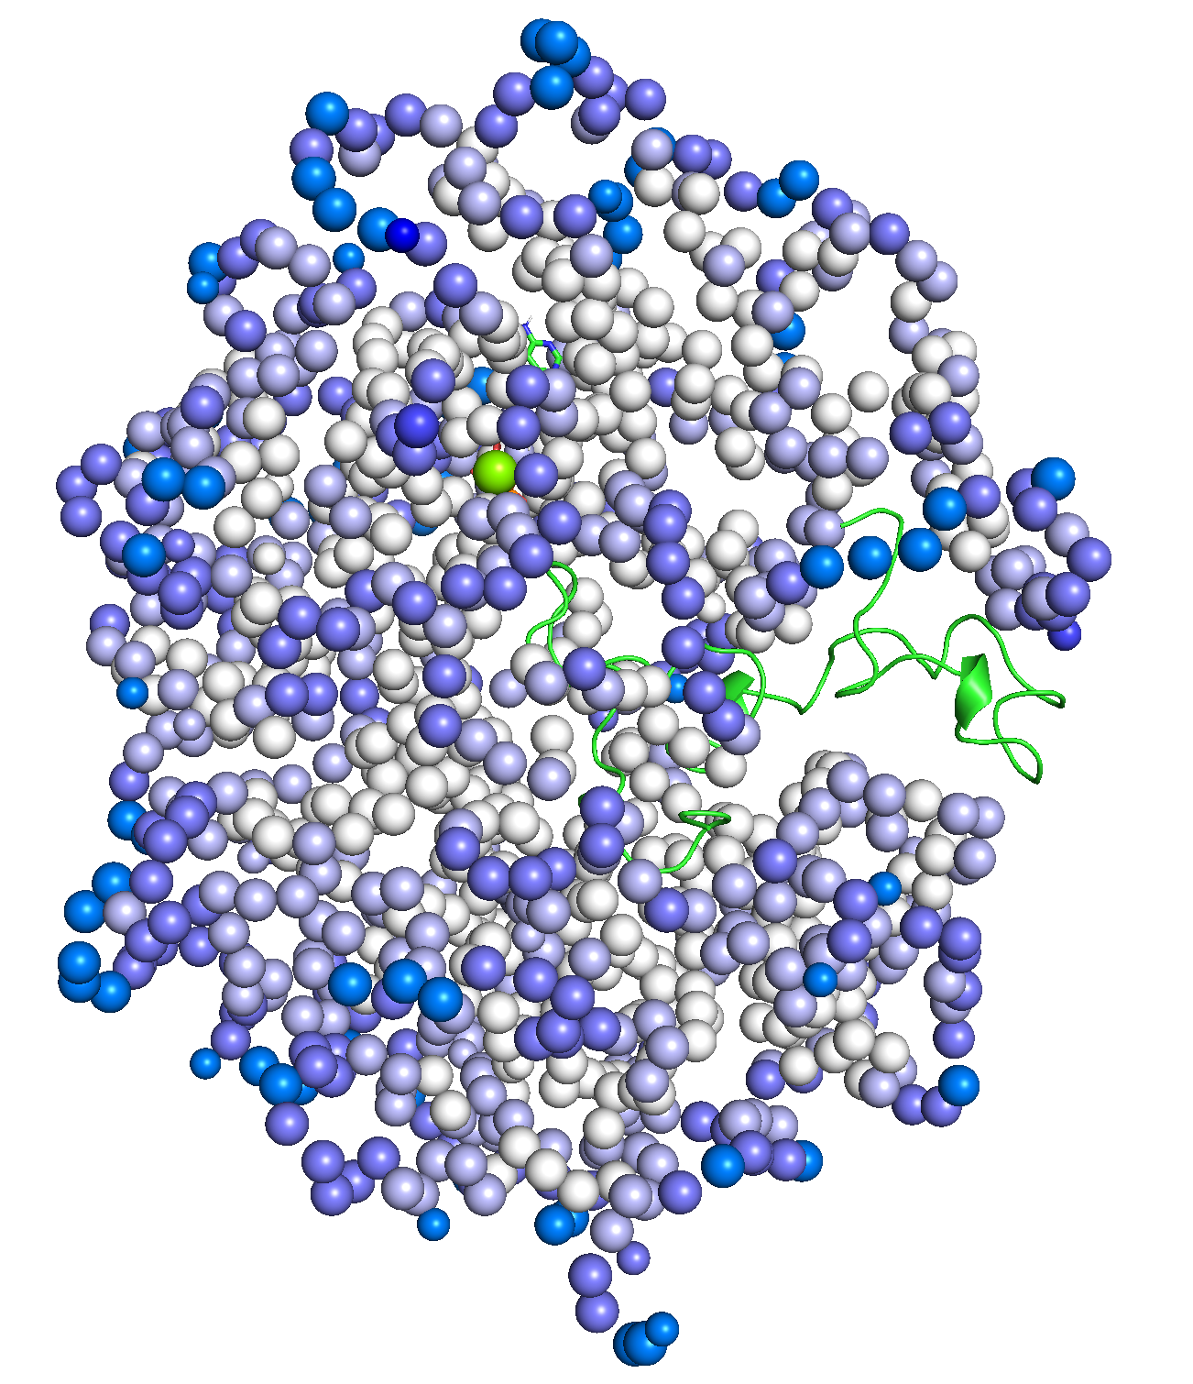
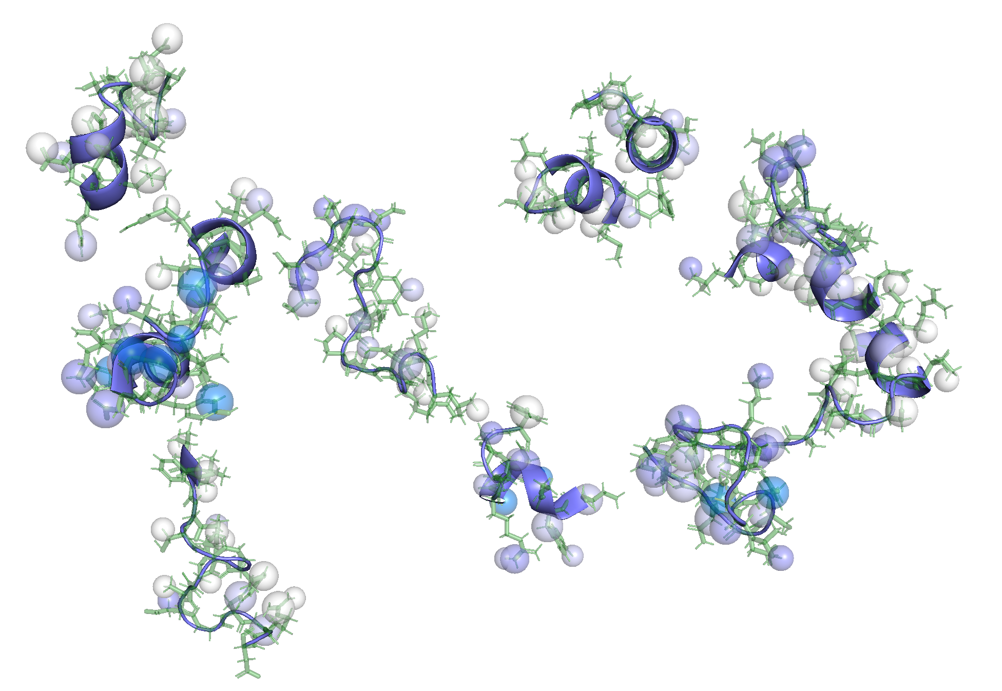
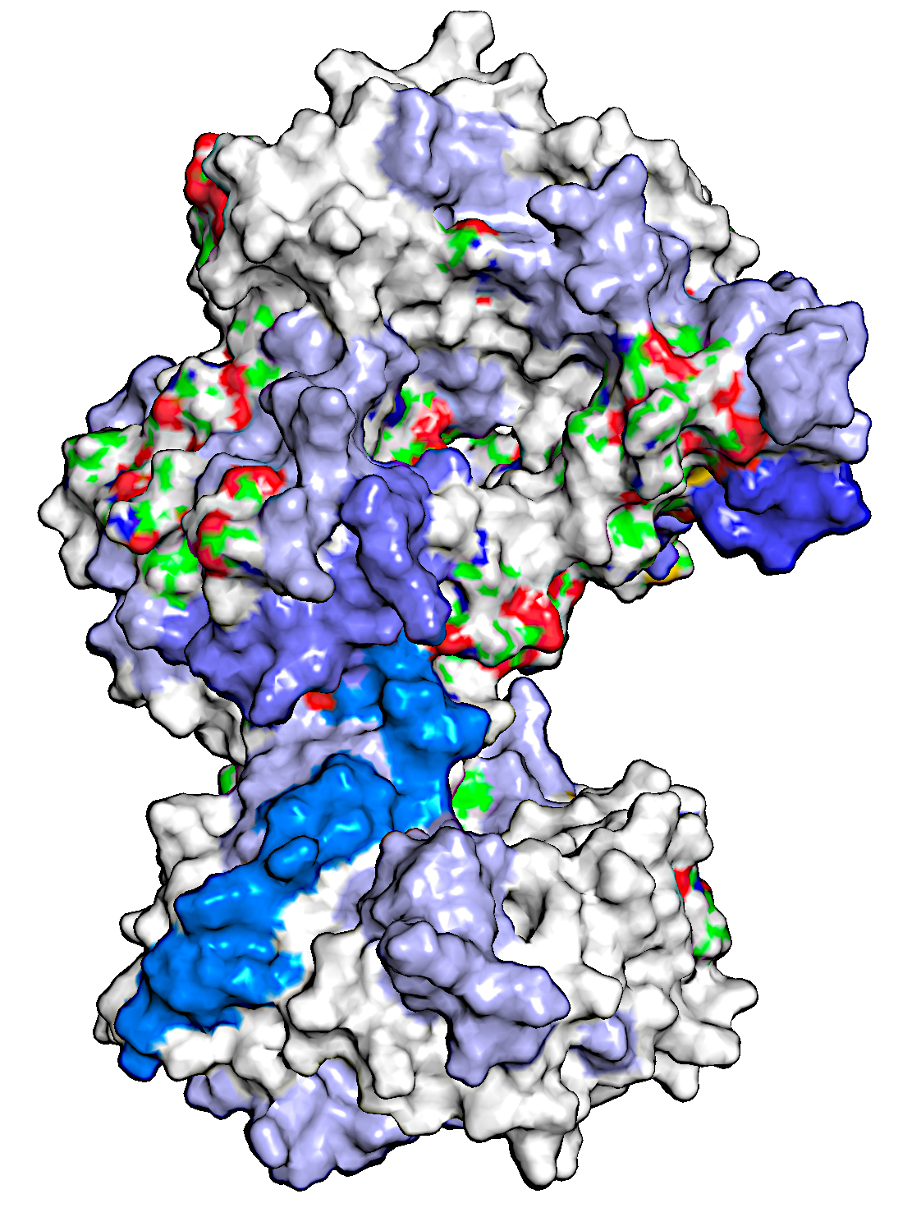
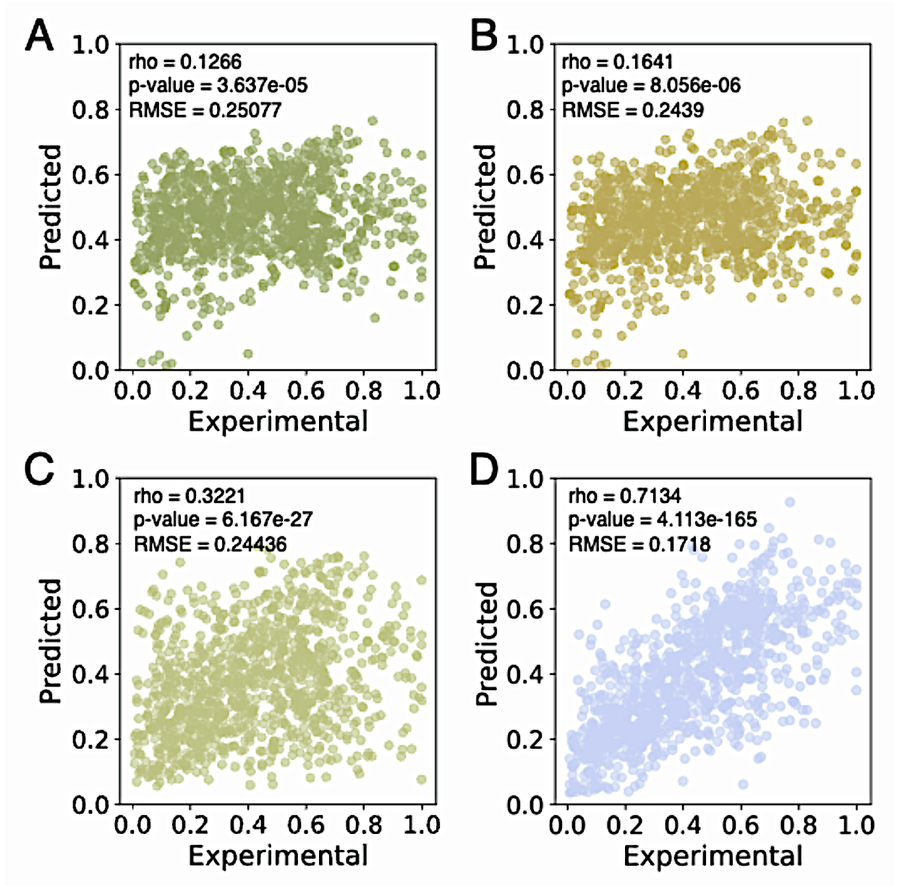
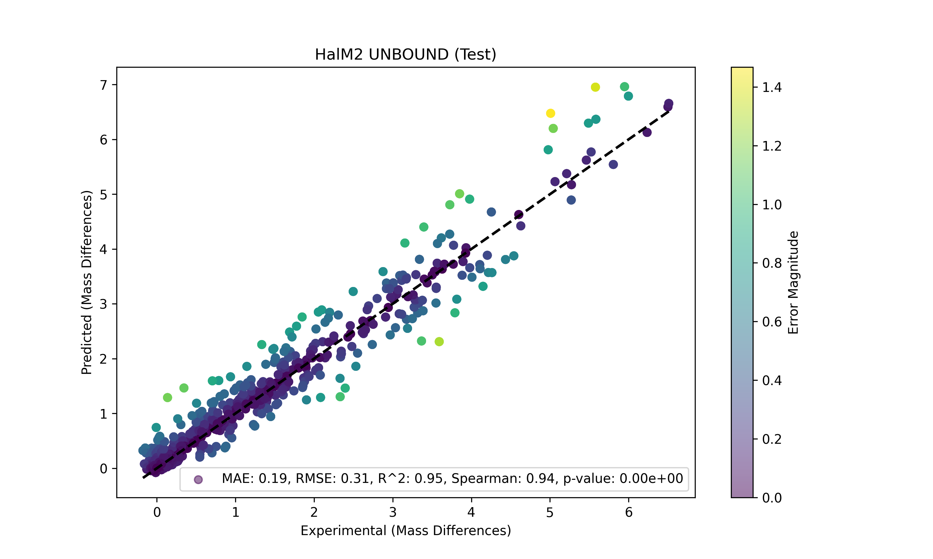
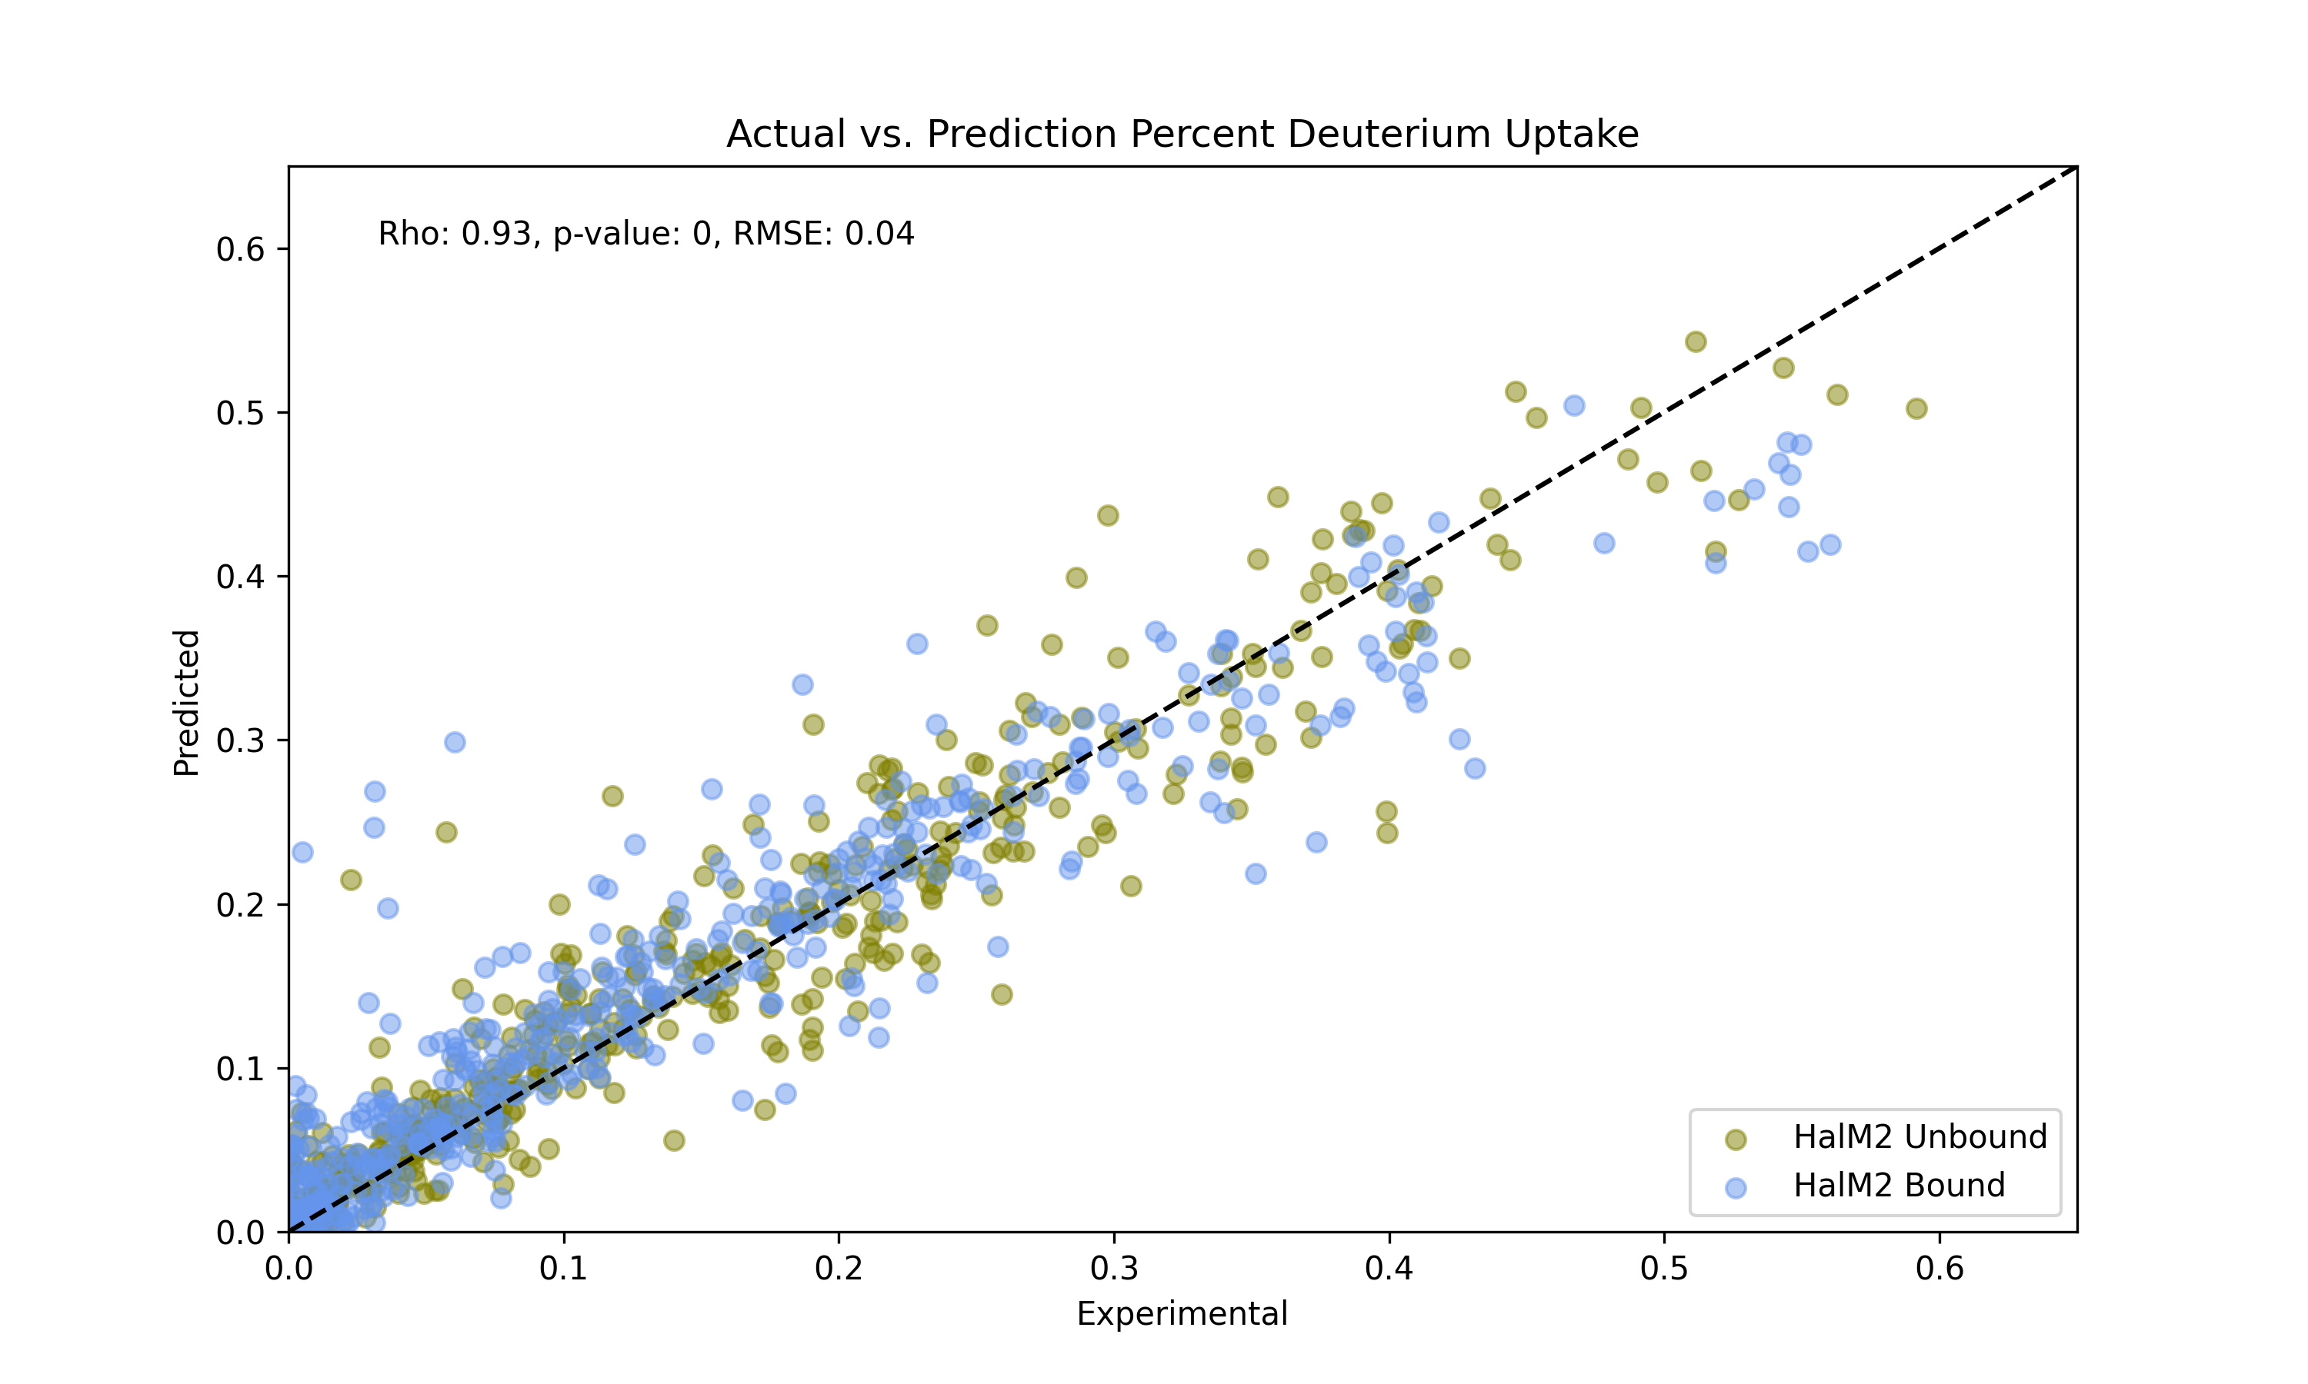
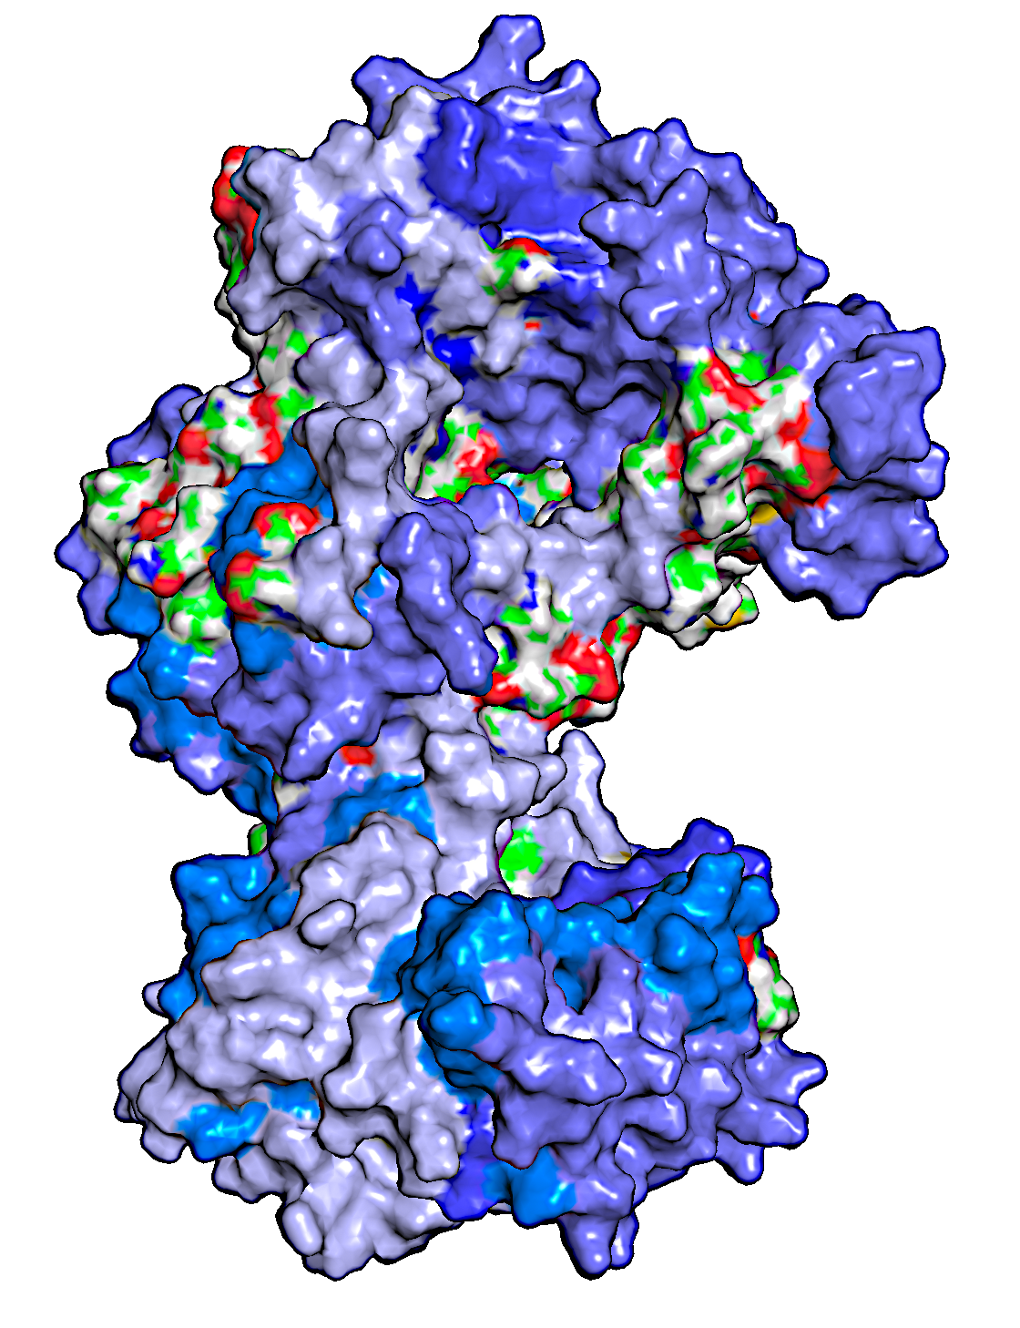
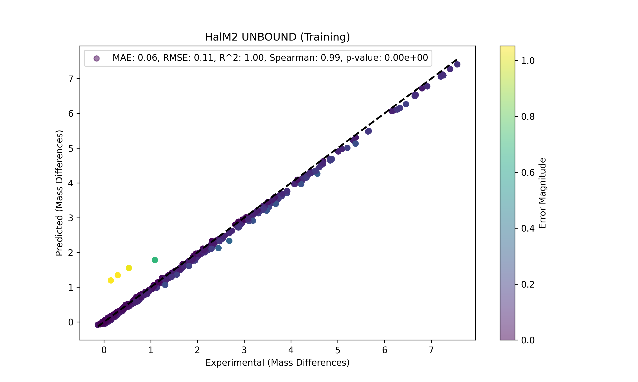
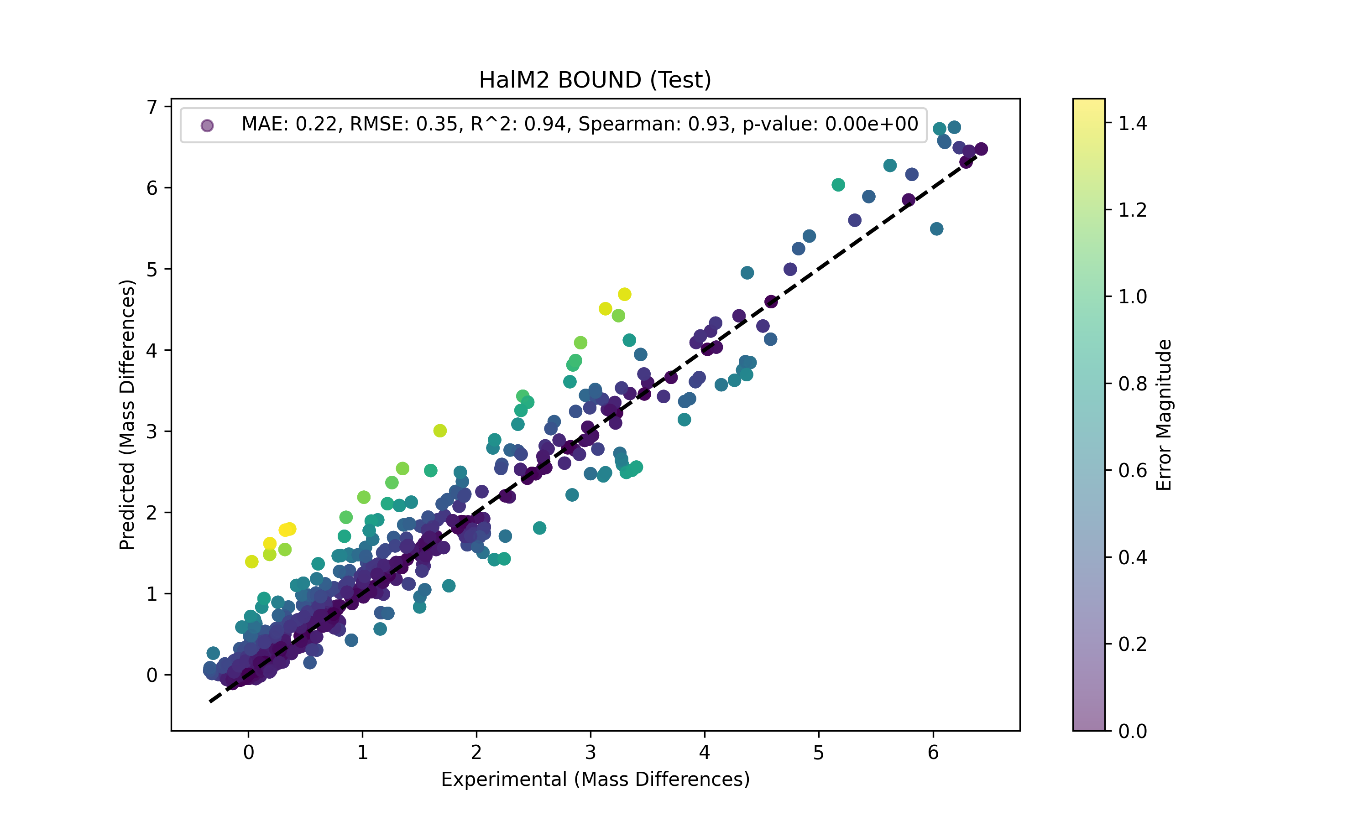
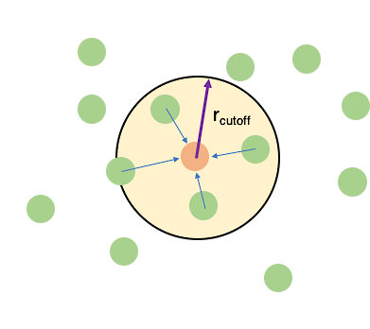
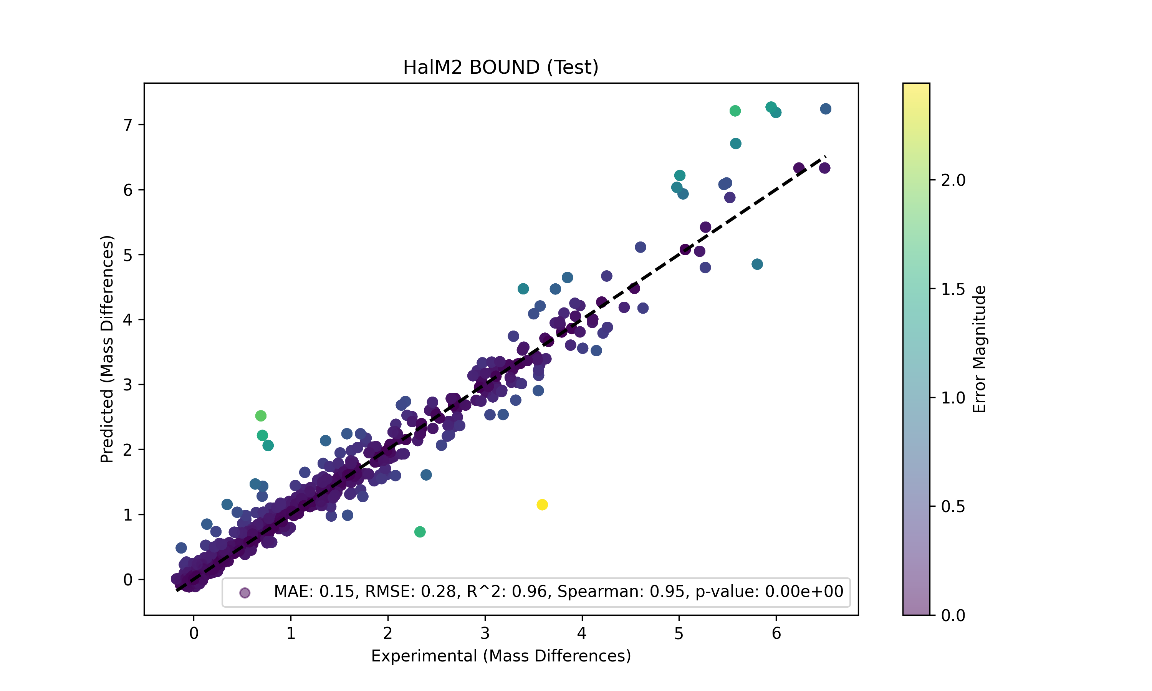
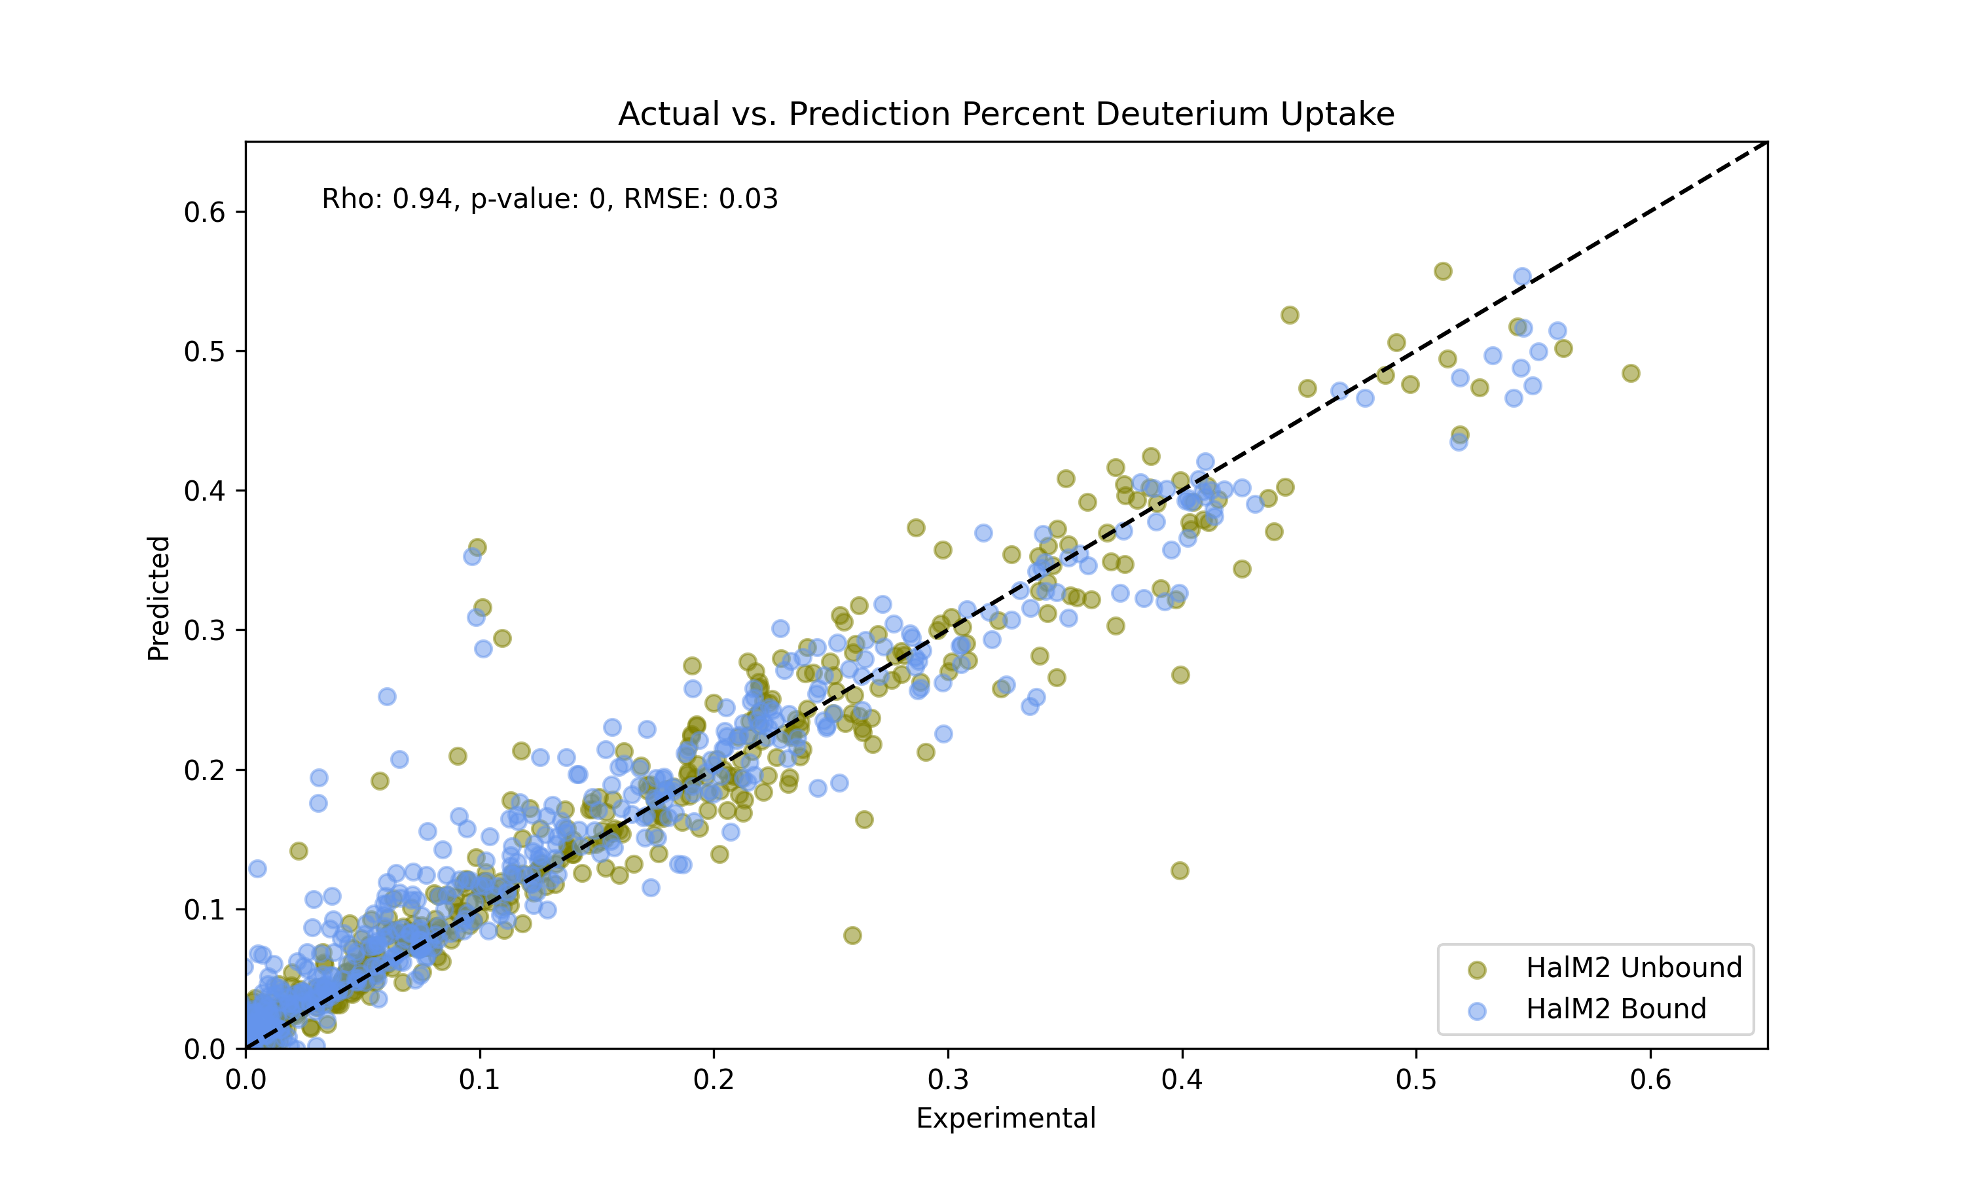
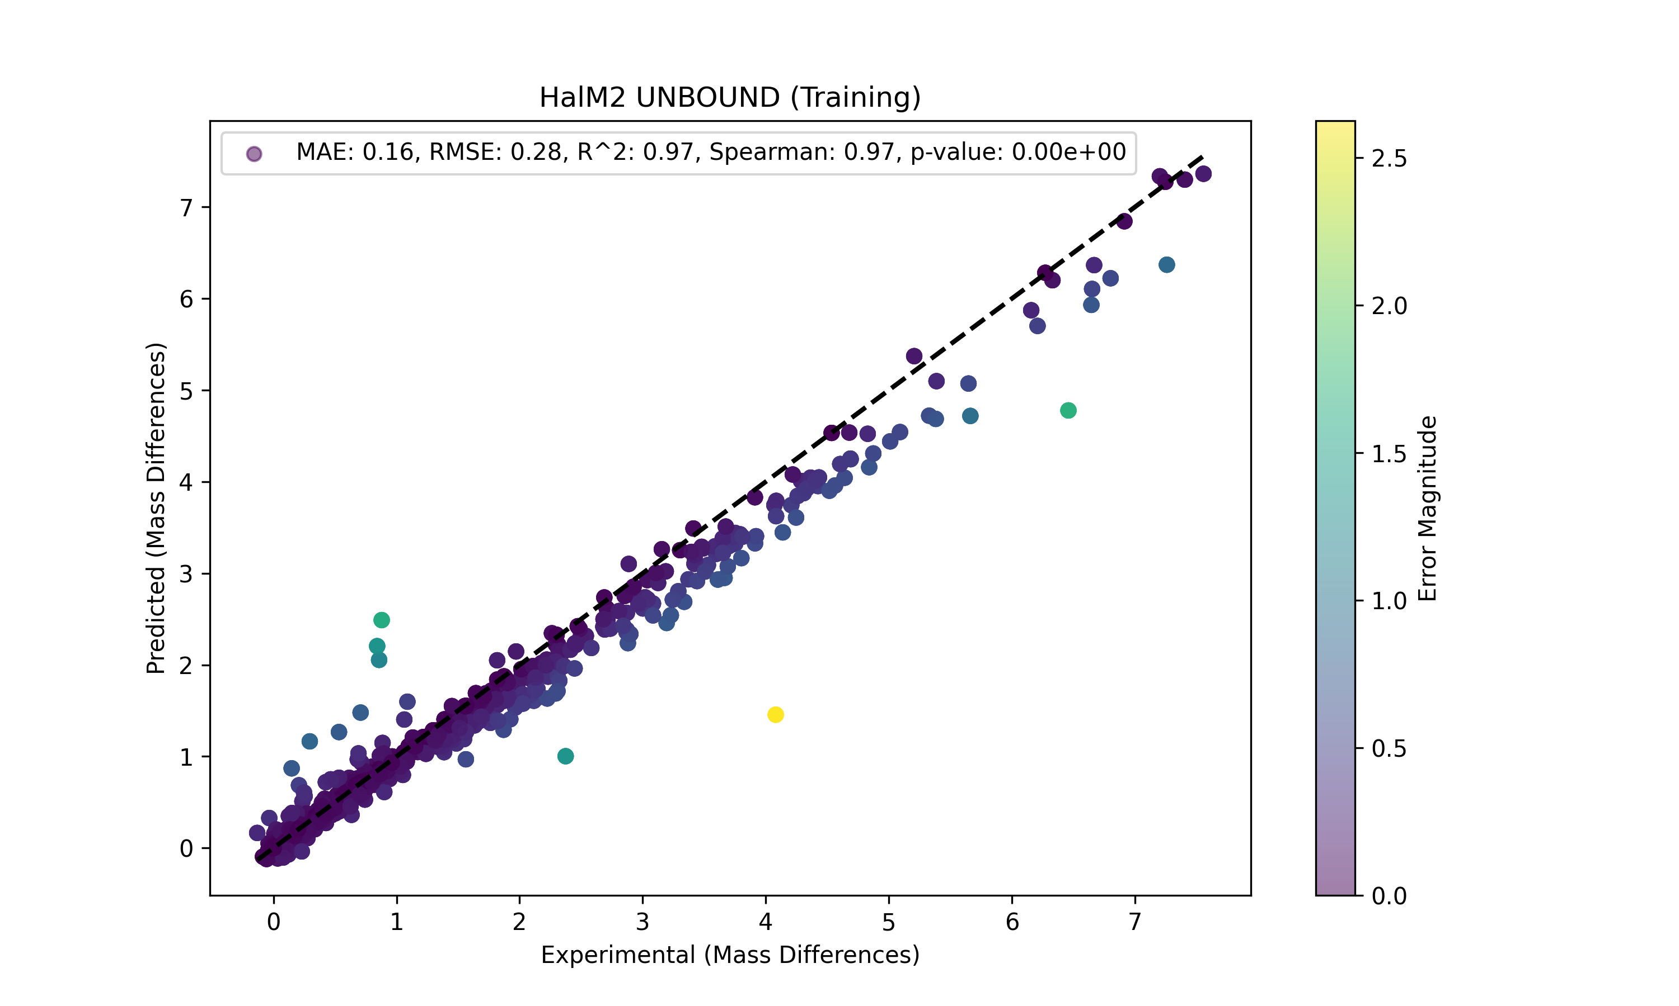
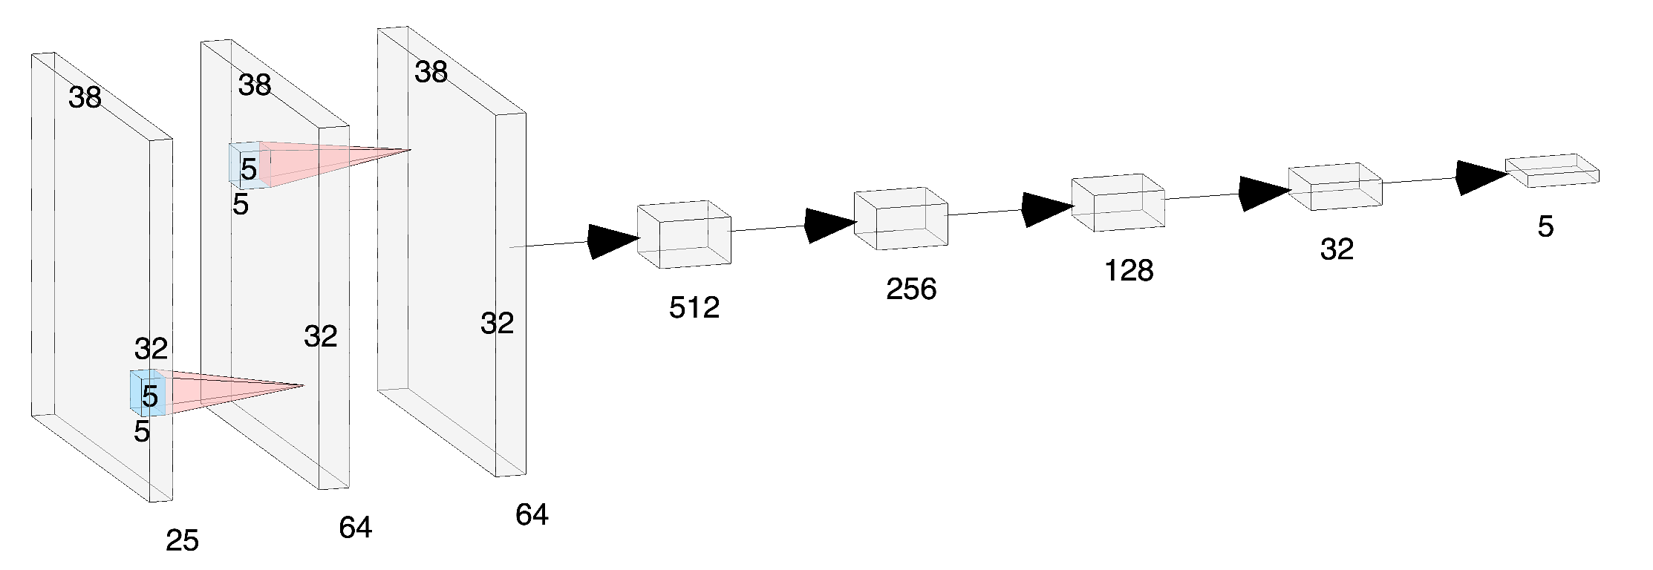
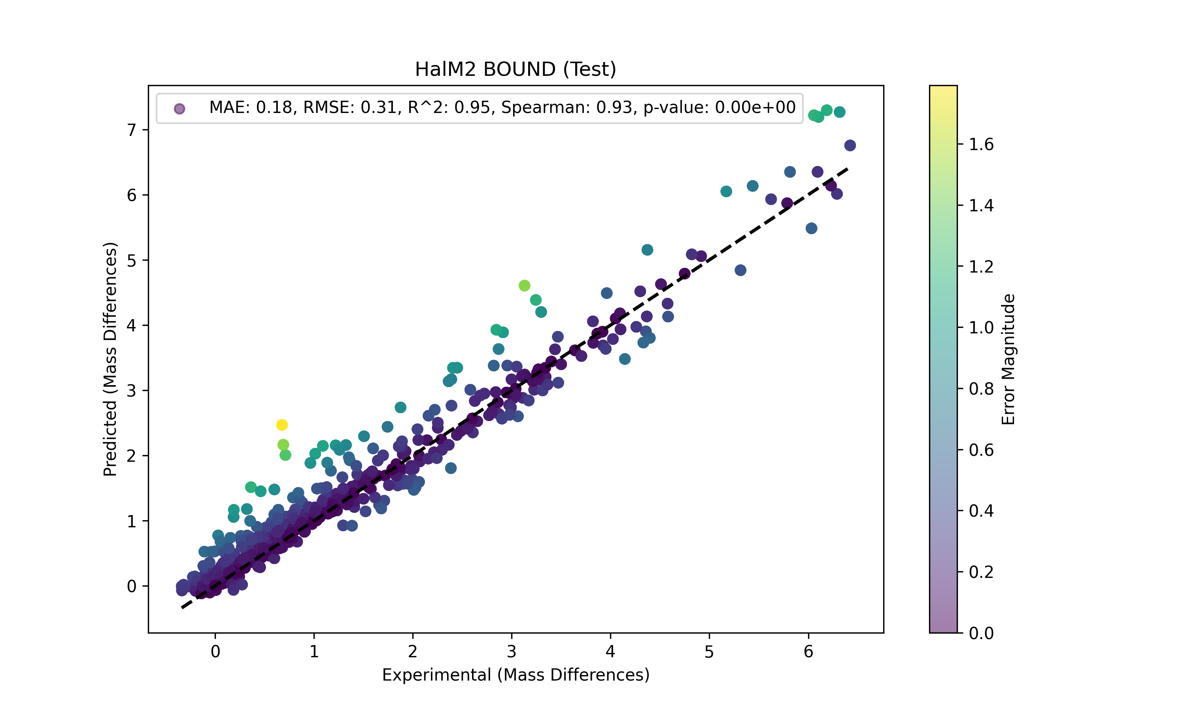
Dynamics 2 Observations (D2O): A Deep Learning Protocol for Mapping Molecular Dynamics Simulations to HDX-MS Measurements
Dominic Fico¹, Christopher Thibodeaux², and Steven Mansoorabadi¹
¹Department of Chemistry and Biochemistry, Auburn University, Auburn, AL-36849; ²Department of Chemistry, McGill University, Montrèal, Canada
Methodology
1. Explicit Solvent aMD
1. Associate tallies with peptide exchange rates
2. Neighbor search on solvent exchangeable atoms
2. Batch/Normalize
1. Train/Predict
Problem:
Predicting HDX-MS exchange rates a priori is difficult
APO HalM2
Interaction Tallies
Neural Network
1. MS/Graph
1. Exposure to D2O
1. Quench
Results/Validation
2. Pepsin Digestion
BOUND HalM2
Deuterium Labeled HalM2
Deuterium Labeled HalM2 Peptides
ACTUAL
Results
7 Å Interaction Sphere
PREDICTED
K-nearest neighbor model (A) and neural network model (C) with MSA only. K-nearest neighbor model (B) and neural network model (D) with MSA and SASA. The rho value indicates Spearman’s correlation coefficient. The p-value determines the statistical significance of the correlation. RMSE indicates the prediction errors between predicted and measured HDX rates, a lower RMSE means a better prediction accuracy.
Goal:
Map molecular dynamics to HDX-MS using machine learning
MDAnalysis Neighbor Search Algorithm
3.5 Å Interaction Sphere
2D Convolution LSTM
Notes:
Show reactions coordinate diagram
Show predicted on Hal Structure
Clearly separate the my old attempts and the paper
HDX-MS pathway in methodology

